Slide 1

Introduction to Optimization (2)
Professor Bo Liu
James Watt School of Engineering

Slide 2
What is the optimization?
Find the best plan or design
Optimization/Search Problem
Conventional optimization methods
AI-based heuristic methods
Advantages: stronger ability, easier to use

Slide 3
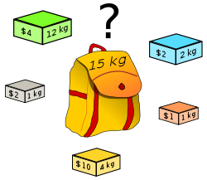
Popular optimization problems: knapsack
Which boxes should be chosen to maximize the amount of money while keeping the overall weight under or equal to 15 kg?
Production planning problem in foundries
What is the difference between TSP and QAP?

Slide 4
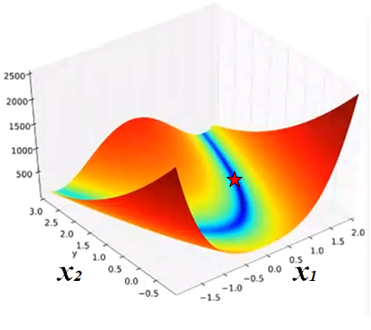

Continuous optimization problems
Continuous Optimization Problem
Example A:
  $\min{f}(x)=100(x_{2}−{x_{1}}^{2})^{2}+(1−x_{1})^{2}$
  $x=(x_{1},x_{2})∈R^{2}$
  The minimum is (1,1) with a minimum function value of 0
  Plot of the function (contour of the function)
Objective function
Search space
Decision variables

Slide 5
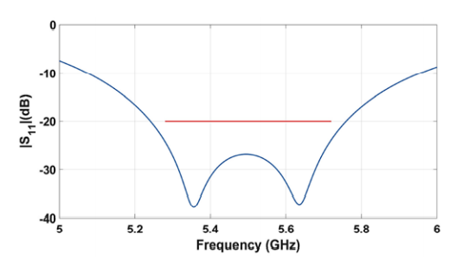
Continuous optimization problems: a real-world example
Continuous Optimization Problem
Example B: Dielectric Resonator Antenna (5.28 GHz – 5.72 GHz)
S₁₁ response

Slide 6
Continuous optimization problems: a real-world example
Continuous Optimization Problem
Design parameters:
variables | ax | ay | az | ac | us | ws | ys
Lower bound | 6 | 12 | 6 | 6 | 0.5 | 4 | 2
Upper bound | 10 | 16 | 10 | 8 | 4 | 12 | 12
Find the optimal design parameters to:
minimize the maximum |S11| from 5.28 GHz to 5.72 GHz
|S11| is obtained by simulation: simulation-based optimization

Slide 7




Thanks!
#UofGWorldChangers
@UofGlasgow

